Slide 1
IMPROPER INTEGRALS

Slide 2
Introduction:
In this topic, the concept of the definite integral will be extended. It will include infinite intervals of integration and integrands that become infinite within the interval of integration which is called improper integrals.

Slide 3
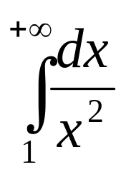
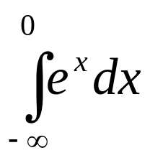
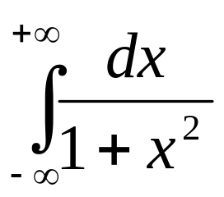
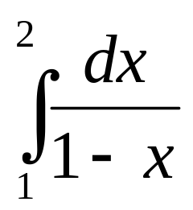
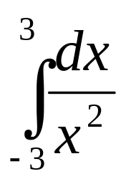
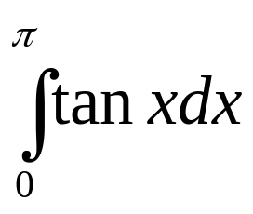
Examples:
Improper Integrals with infinite intervals of integration
Improper integrals with infinite discontinuities in the interval of integration

Slide 4
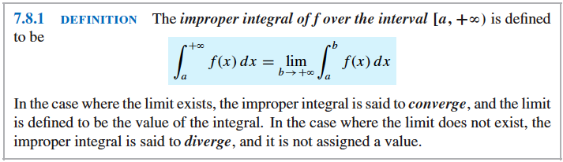
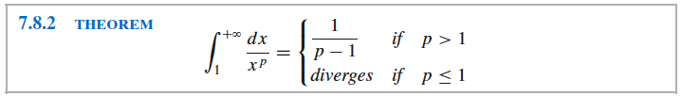
INTEGRALS OVER INFINITE INTERVALS

Slide 5
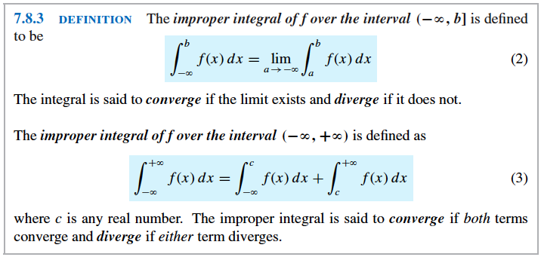

Slide 6
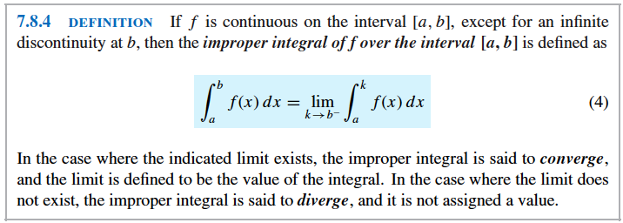

Slide 7
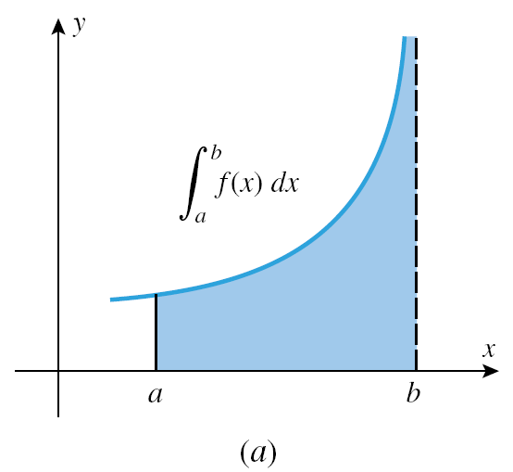
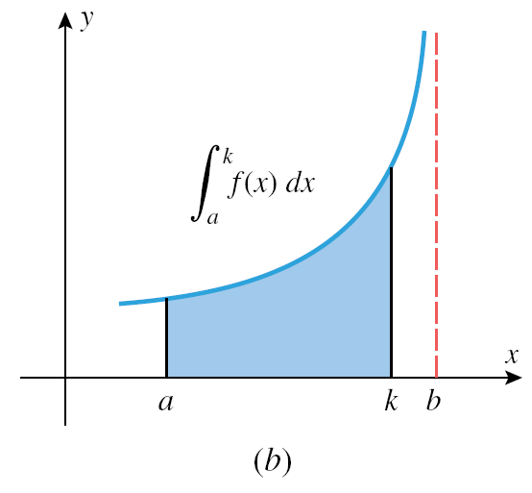

Slide 8
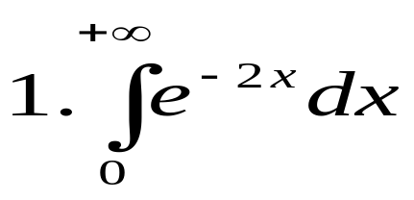
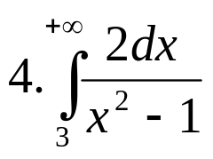
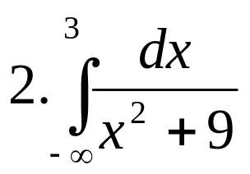
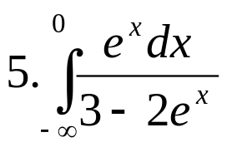
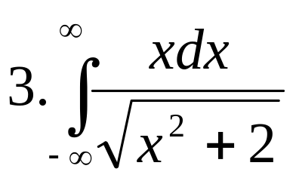
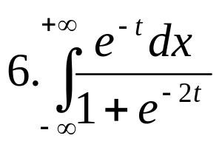
Examples: Evaluate the following integrals

Slide 9
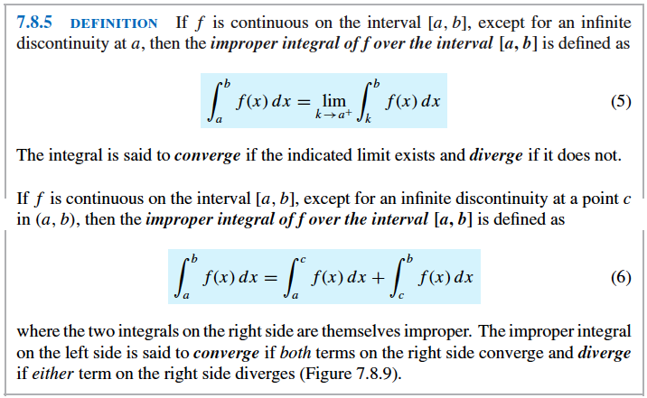
INTEGRALS OVER INFINITE INTERVALS

Slide 10
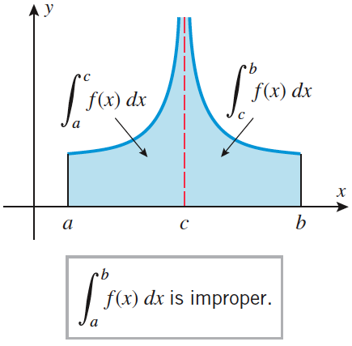
Figure 7.8.9 (p. 552)

Slide 11
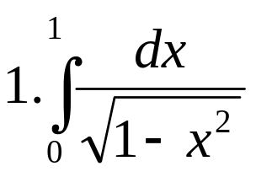
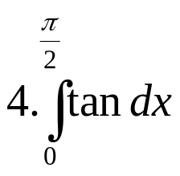
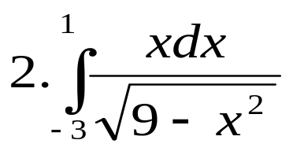
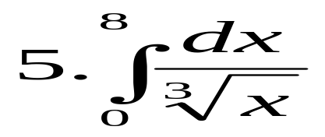
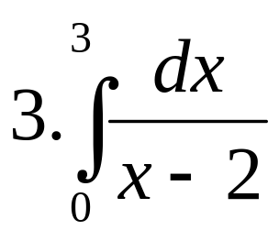
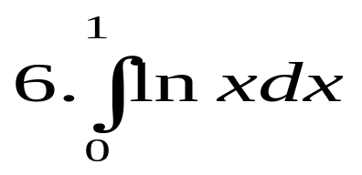
Examples: Evaluate the following integrals

Slide 12
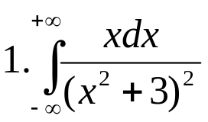
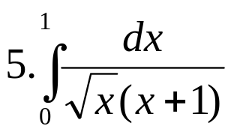
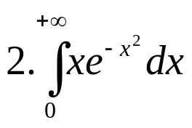
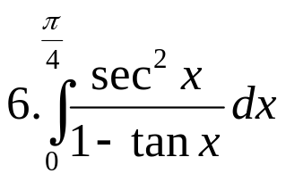
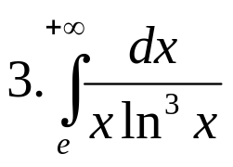
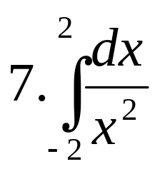
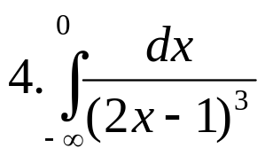
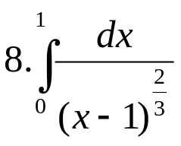
HOMEWORK #1 (Part 1 – Improper Integrals)

Slide 13
Application of Improper Integrals
Area
Volume

Slide 14
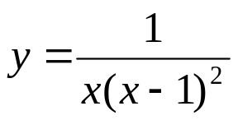
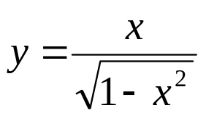
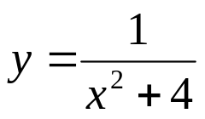

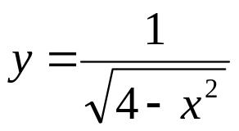
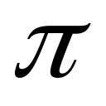
Area
Find the area of the region
1. above the x-axis under and to the
right of x =2. Ans: 1 – ln 2 sq.unit
2. between the curves , the x –axis ,
x= 0 and x =1. Ans: 1 sq.unit
3. bounded by and the x –axis. Ans:
4. bounded by the curve , its
asymptotes and the x-axis. Ans:

Slide 15
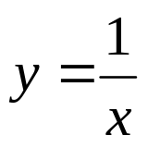
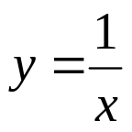
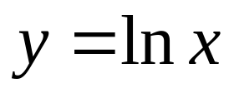


5. under between x = 0 and x =1
6. under and to the right of x =1
7. under from the right of x =1.
8. under from x = 0 to x = .

Slide 16
Volume
Find the volume of the solid
under the curve xy =1, for x≥1 is rotated about the x-axis.
between the graph of y = ln (1/x), the x-axis, and the y-axis is revolved about the x-axis.

Slide 17
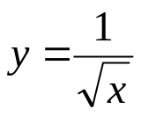
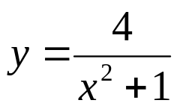

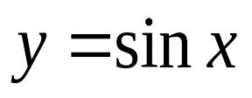

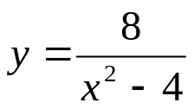
HOMEWORK #1 (Part 2 – Applications of Improper Integrals)
Find the area of the region
1. bounded by and the line x = 1.
2. bounded by the curve , the x-axis
and to the right of the line x = 1.
3. under the curve , for x ≥ 1.
under for x ≥ 0
between the x-axis and the curve for
x ≥ 0.
6. between the x-axis and the curve for
x ≥ 4.

Slide 18
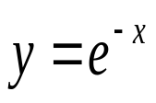
Find the volume of the solid
1. Suppose that the region between the x-axis and the curve for x ≥ 0 is revolved about the x-axis. Find the volume of the solid that is generated.
2. That is generated when the region between the x-axis and the curve y = 1/e^{x} for x≥0 is revolved about the x-axis.

